Slide 1
2018-19 nfhs wrestling rules powerpoint
B. Elliot Hopkins, MLD, CAA
Director of Sports, Sanctioning and Student Services

Slide 2

NFHS Corporate partner
Notes:
The NFHS welcomes and thanks Danmar Warrior Wrestling as one of the NFHS corporate partners. As their status with the NFHS has been contractually established, they are the only company that can use our logo/wordmark.
Congratulations to Danmar for 51 years of specializing in wrestling equipment.
Warriors work. Warriors win.

Slide 3
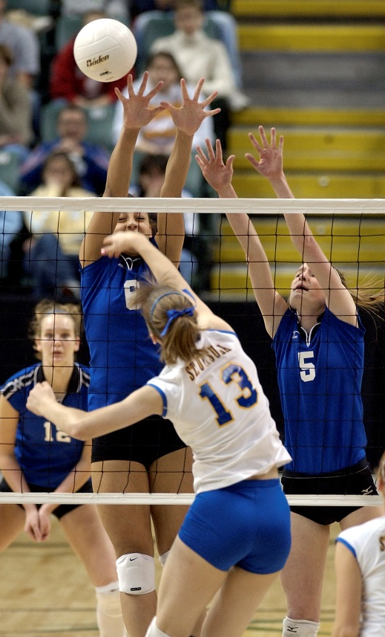
National Federation of
State High School Associations
NFHS (located in Indianapolis, IN – Est. 1920):
  National leadership organization for high school sports and fine arts activities;
  National authority on interscholastic
  activity programs.
  Conducts national meetings;
  Sanctions interstate events;
  Produces national publication for
  high school administrators;
  National source for interscholastic coach
  training and national information center.

Slide 4

National Federation of
State High School Associations
Membership = 50 member state associations and D.C.
NFHS reaches more than 19,000 high schools and 12 million participants in high school activity programs, including more than 7.8 million in high school sports.

Slide 5








NFHS Rules Review Committee
The NFHS Rules Review Committee is chaired by the chief operating officer and composed of all rules editors. After each committee concludes its deliberations and has adopted its recommended changes for the subsequent year, such revisions will be evaluated by the Rules Review Committee.
Davis Whitfield
Chief Operating Officer
Lindsey Atkinson
Volleyball
Bob Colgate
Football and Sports
Medicine
Sandy Searcy
Softball and Swimming & Diving
Elliot Hopkins
Baseball and Wrestling
Julie Cochran
Cross Country, Gymnastics, Field Hockey and
Track & Field
James Weaver
Boys and Girls Lacrosse and Spirit
Theresia Wynns
Basketball and Soccer
Dan Schuster
Ice Hockey

Slide 6
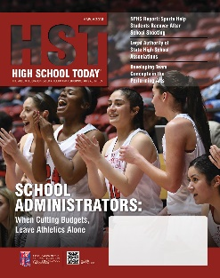











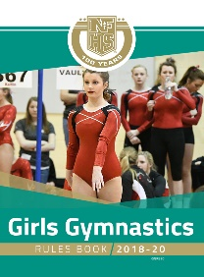





National Federation of
State High School Associations
The NFHS writes playing rules for 17 sports for boys and girls at the high school level.
  Publishes 4 million pieces of materials annually.

Slide 7

NFHS Rules Book as e-Books
E-books features:
  Searchable
  Highlight areas of interest
  Make notes
  Desktop laptop availability
  Easy navigation
  Adjustable viewing size
  Immediate availability

Slide 8

Guidelines for Schools and state associations for consideration of accommodations
Notes:
To assist state associations in working with schools for the inclusion of students with disabilities the following guide prepared by the NFHS Task Force on the Inclusion of Students with Disabilities is being provided for your review.
Following these guidelines will assist in the individual student assessment by the student and the school.
When requesting a possible accommodation, coaches should work with their school and the state association as early as possible in the sport season.
Contest officials shall defer decisions on rule accommodations to the respective state association.
This information serves as a guide. Each state association may develop its own process.

Slide 9
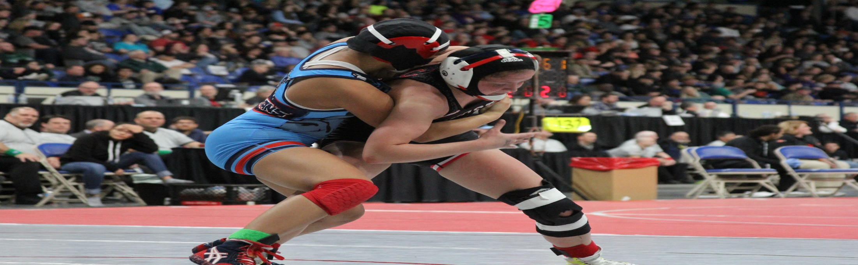
NFHS WRESTLING rULES CHANGES

Slide 10
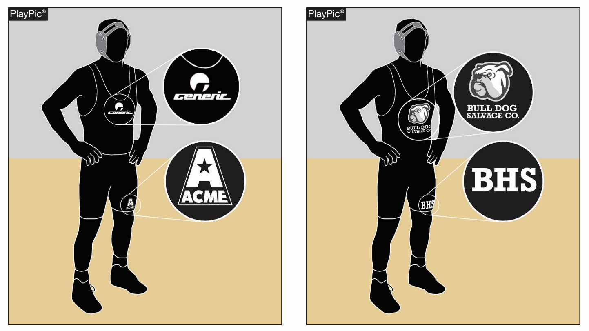
UNIFORMS
RULE 4-1-2
A
B
Any manufacturer's logo/trademark/reference that appears on the wrestling uniform can be no more than 2 1/4 square inches with no dimension more that 2 1/4 inches and may appear no more than once on each item of uniform apparel (PlayPic A). No additional manufacturer’s logo/trademark nor a promotional reference shall be allowed on the wrestling uniform (PlayPic B).

Slide 11
Uniforms rule 4-1-2
ART. 2 . . . Any manufacturer's logo/trademark/reference that appears on the wrestling uniform can be no more than 2 1/4 square inches with no dimension more that 2 1/4 inches and may appear no more than once on each item of uniform apparel. No additional manufacturer’s logo/trademark nor a promotional reference shall be allowed on the wrestling uniform.

Slide 12
Uniforms rule 4-1-2
Rationale:
Additional logos, trademarks and promotional markings are frequently being applied to the wrestling uniform. This rule allows for minimal disruption of the sanctity of the wrestling uniform and attempts to prevent the exploitation of students.

Slide 13
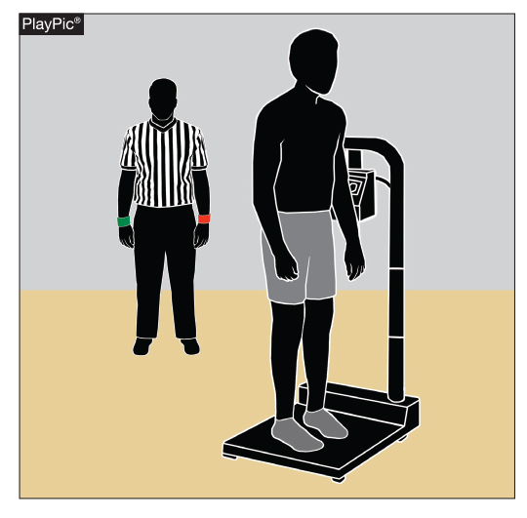
Weigh-ins rule 4-5-7
Contestants may wear low-cut socks during weigh-ins that cannot be removed or added if the wrestler does not make weight.

Slide 14
Weigh-in rule 4-5-7
ART. 7 . . . All contestants shall weigh in wearing a suitable undergarment that completely covers the buttocks and groin area. Female contestants must also wear a suitable undergarment that covers their breasts. Contestants may wear low-cut socks that cannot be removed or added if the wrestlers do not make weight.

Slide 15
Weigh-in rule 4-5-7
Rationale:
Risk minimization. Feet are typically not inspected during a normal skin check. The wearing of low-cut socks will give contestants an option to prevent the spreading of athlete’s foot and other foot infections.

Slide 16
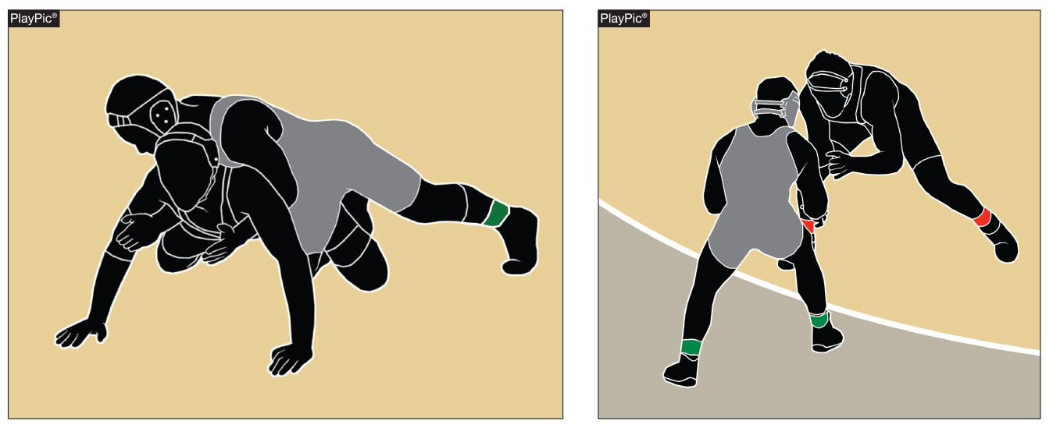
Escape rule 5-10
A
B
The defensive wrestler in PlayPic A scores an escape in PlayPic B because he/she has gained a neutral position and there are two supporting points of either wrestler inbounds.

Slide 17
Escape rule 5-10
An escape is when the defensive wrestler gains a neutral position and the opponent has lost control, beyond reaction time, while a total of two supporting points of either wrestler are inbounds. The total of two supporting points could be two supporting points of one wrestler or one supporting point of each wrestler.

Slide 18
Escape rule 5-10
Rationale:
This rule defines what an escape is in conjunction with the new definition of supporting points. This simplifies the explanation with any combination of two supporting points of either wrestler is considered inbounds.

Slide 19
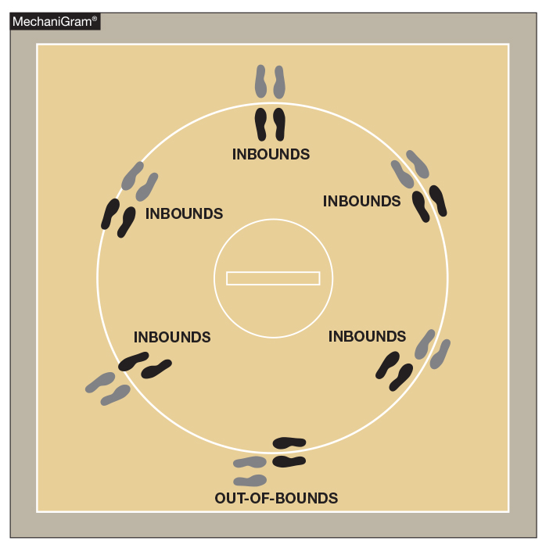
Inbounds rule 5-15-1
Contestants are considered to be inbounds if a total of two supporting points of either wrestler are inside or on the boundary lines. The total of two supporting points could be two supporting points of one wrestler or one supporting point of each wrestler that are inside or on the boundary lines.

Slide 20
Inbounds
Rule 5-15-1
ART. 1 . . . Contestants are considered to be inbounds if a total of two supporting points of either wrestler are inside or on the boundary lines. (Photo 11) The total of two supporting points could be two supporting points of one wrestler or one supporting point of each wrestler that are inside or on the boundary lines.

Slide 21
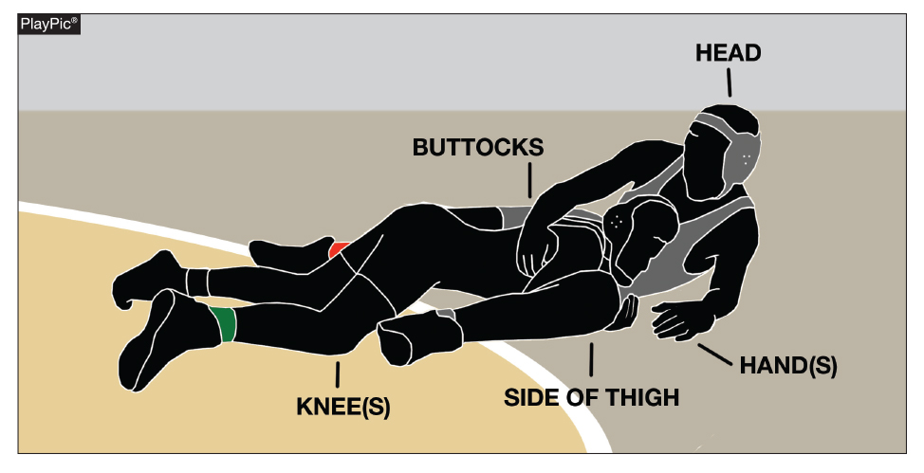
Inbounds rule 5-15-2a
Supporting points are the parts of the body touching the wrestling area which bear the wrestler's weight, other than those parts with which the wrestler is holding the opponent.

Slide 22
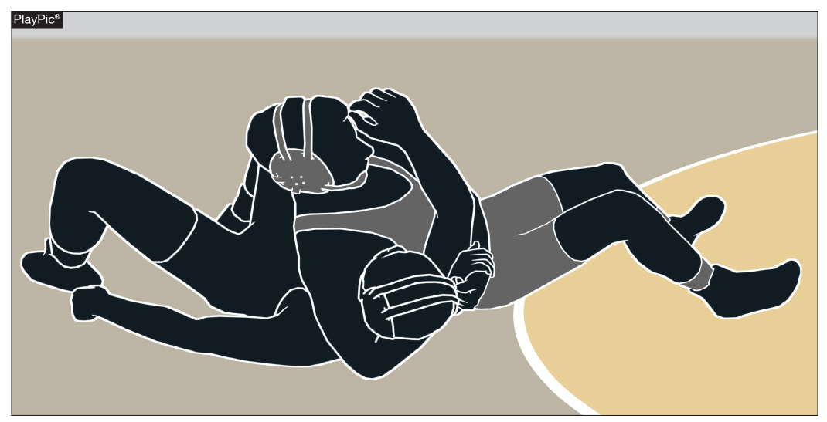
Inbounds rule 5-15-2c
In a pinning situation when all parts of a defensive wrestler shoulders / scapula are beyond the boundary line, if the feet including toes and heels of the offensive wrestlers are the supporting points, the offensive wrestlers knee(s) must be inside the boundary, whether in contact with or above the mat.

Slide 23
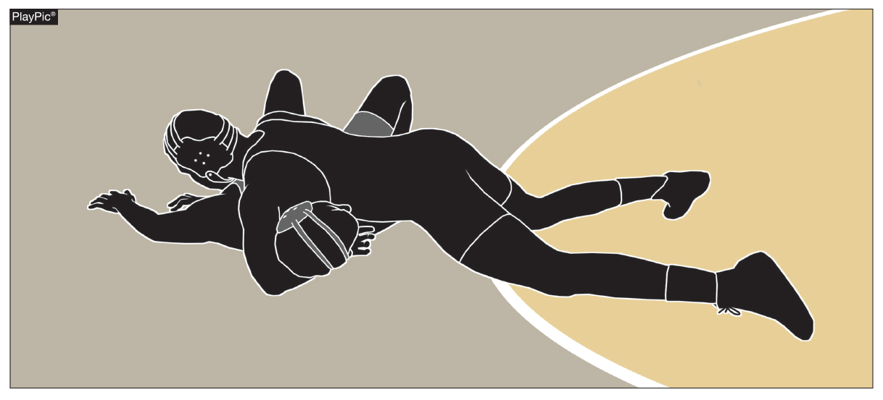
inbounds rule 5-15-2c
In a pinning situation when all parts of a defensive wrestler shoulders / scapula are beyond the boundary line, if the feet including toes and heels of the offensive wrestlers are the supporting points, the offensive wrestler’s knee(s) must be inside or on the boundary, whether in contact with or above the mat.

Slide 24
Inbounds
Rule 5-15-2a-c
ART. 2 . . . Supporting points are the parts of the body touching the wrestling area which may or may not bear the wrestler's weight, other than those parts with which the wrestler is holding the opponent.
a. When down on the mat, the usual points of support are:
1. the knee(s);
2. the side of the thigh;
3. the buttocks;

Slide 25
Inbounds
Rule 5-15-2a-c
4. the hand(s);
5. the head.
b. When the defensive wrestler is on their back while the supporting points of either wrestler are inbounds wrestling shall continue. In this situation any part of a defensive wrestler's shoulder or scapula is considered to be all the supporting points.

Slide 26
Inbounds
Rule 5-15-2c
c. Near-fall points or fall shall be earned only while the supporting points of either wrestler are inbounds. In a pinning situation, when all parts of the defensive wrestler’s shoulders/scapula are on the mat area beyond the boundary line, if the feet including toes and heels of the offensive wrestler are the supporting points, the offensive wrestler’s knee(s) must be inside the boundary, whether in contact or above the mat.

Slide 27
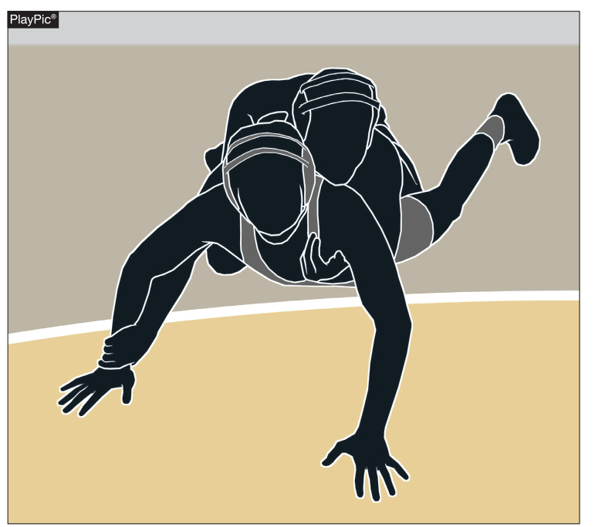
Inbounds rule 5-15-3
The total of two supporting points could be two supporting points of one wrestler or one supporting point of each wrestler that remain inbounds. If there is no action at the edge of the mat, the referee shall stop the match.

Slide 28
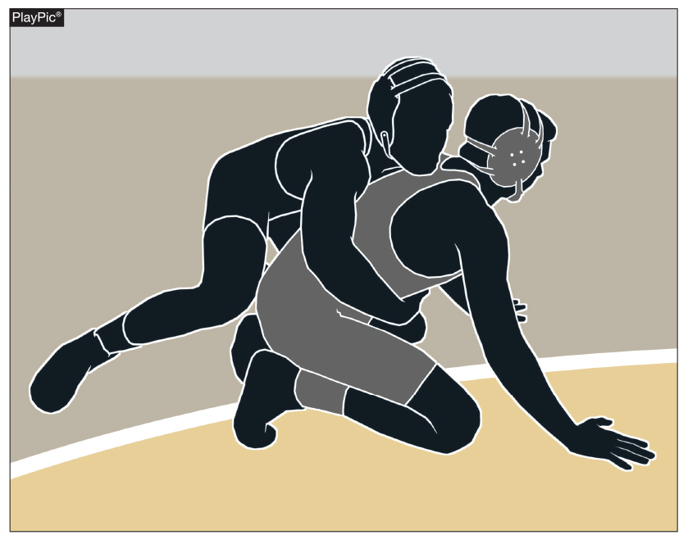
Inbounds rule 5-15-3
Even if the defensive wrestler has two supporting points inbounds, if there is no action at the edge of the mat, the referee shall stop the match for a restart in the center of the mat.

Slide 29
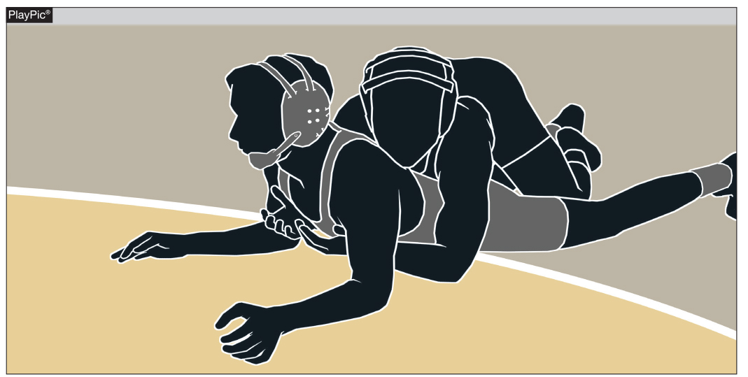
Inbounds rule 5-15-3
A2
A1
Wrestling shall continue as long as a total of two supporting points of either wrestler are inside or on the boundary lines. In this PlayPic, the wrestlers are inbounds. The bottom wrestler’s elbows and hands are the two supporting points.

Slide 30
Inbounds
Rule 5-15-3
ART. 3. . . Wrestling shall continue as long as a total of two supporting points of either wrestler are inside or on the boundary lines. The total of two supporting points could be two supporting points of one wrestler or one supporting point of each wrestler that remain inbounds. If there is no action at the edge of the mat the referee shall stop the match.

Slide 31
Inbounds
Rules 5-15-1,2 and 3
Rationale:
This rule removes the subjectivity in the out of bounds call without increasing the out of bounds area. In addition, it assists the referee’s call out of bounds more consistently. Changing the knees to knee(s) is consistent with sub-article 5-15-2a4. The removal of “majority of weight” criteria will aid the referee in focusing on the supporting points that are inbounds instead of what is out of bounds.

Slide 32
Inbounds
Rules 5-15-1,2 and 3
This simplifies the determination with any combination of two supporting points is considered inbounds. The modification clearly defines the offensive wrestler’s supporting points in a pinning situation. No wrestling action at the edge of the mat will result in the referee stopping the match.

Slide 33
Supporting points comment
Interscholastic wrestling is uniquely different than any other type of wrestling in the world. We are challenged by a wide variety of gymnasiums and mat sizes. The NFHS Wrestling Rules Committee had a healthy discussion regarding toes, feet and heels as supporting points. There was no action taken to add toes, feet or heels as usual supporting points down on the mat. They were also not addressed as unusual supporting points.

Slide 34
Supporting points comment
Toes, feet and heels down on the mat and knees inbounds are addressed during a fall or near-fall only. (5-15-2c)
Supporting points will apply to all positions. The only exception would be near-fall/fall out of bounds where the knees cannot go past the boundary line if the offensive wrestler’s weight is on their feet, toes or heels.

Slide 35
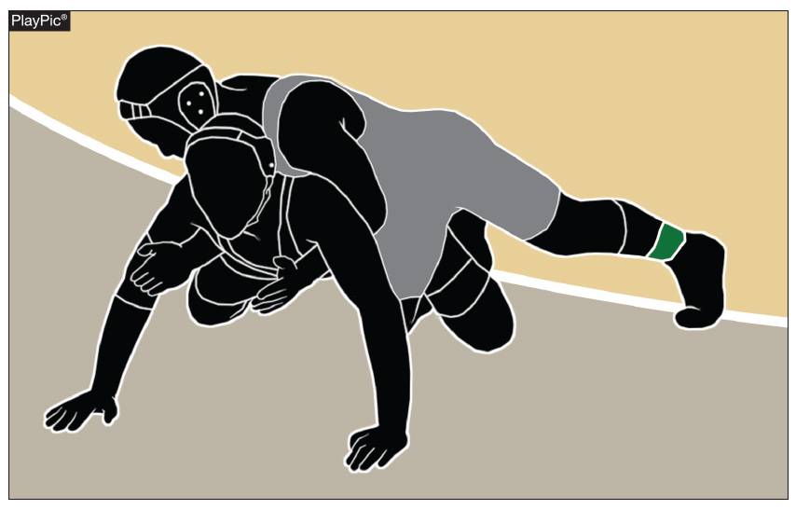
Out of bounds rule 5-18
Out of bounds occurs when there are no longer two total supporting points inside or on the boundary line. The total of two supporting points could be two supporting points of one wrestler or one supporting point of each wrestler inside or on the boundary line.

Slide 36
Out of Bounds
Rule 5-18
Out of bounds occurs when there are no longer two total supporting points inside or on the boundary line. The total of two supporting points could be two supporting points of one wrestler or one supporting point of each wrestler inside or on the boundary line. (Photo 11)

Slide 37
Out of Bounds
Rule 5-18
Rationale:
This rule would eliminate the subjectivity in the out-of- bounds call without increasing the out-of-bounds area. It also assists the referees call out of bounds more consistently. The removal of the “majority of weight” criteria will aid the referee in focusing on inbounds and out-of-bounds, rather than trying to make a judgment on weight-bearing extremities.

Slide 38
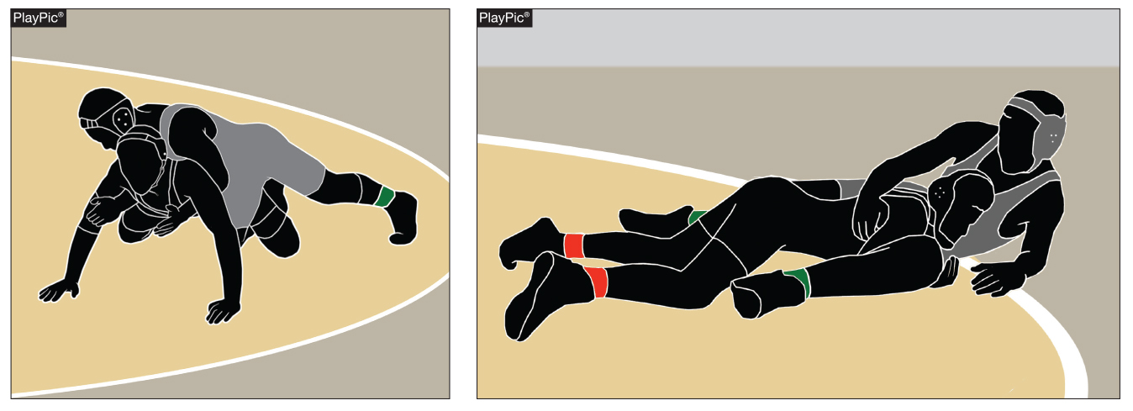
Reversal rule 5-22-1-2
In awarding a reversal at the edge of the mat, control must be established while the total of two supporting points of each wrestler inside or on the boundary line. The total of two supporting points could be two supporting points of one wrestler or one supporting point of each wrestler inside or on the boundary line or while at least the feet of the scoring contestant finish down on the mat inbounds.

Slide 39
Reversal rule 5-22-1
ART. 1 . . . It is a reversal when the defensive wrestler comes from underneath and gains control of the opponent, either on the mat or in a rear-standing position, while the total of two supporting points are inside or on the boundary line. Two supporting points could be two supporting points of one wrestler or one supporting point of each wrestler. If there is no action at the edge of the mat, the referee shall stop the match. (Photos 21 & 22)

Slide 40
Reversal rule 5-22-2
ART. 2 . . . In awarding a reversal at the edge of the mat, control must be established while the total of two supporting points of each wrestler inside or on the boundary line. The total of two supporting points could be two supporting points of one wrestler or one supporting point of each wrestler inside or on the boundary line or while at least the feet of the scoring contestant finish down on the mat inbounds.

Slide 41
Reversal rule 5-22-1-2
Rationale:
This rule defines what a reversal is in conjunction with the new definition of supporting points. This simplifies the explanation with any combination of two supporting points of either wrestler is considered inbounds. No wrestling action at the edge of the mat will result in the referee stopping the match.

Slide 42
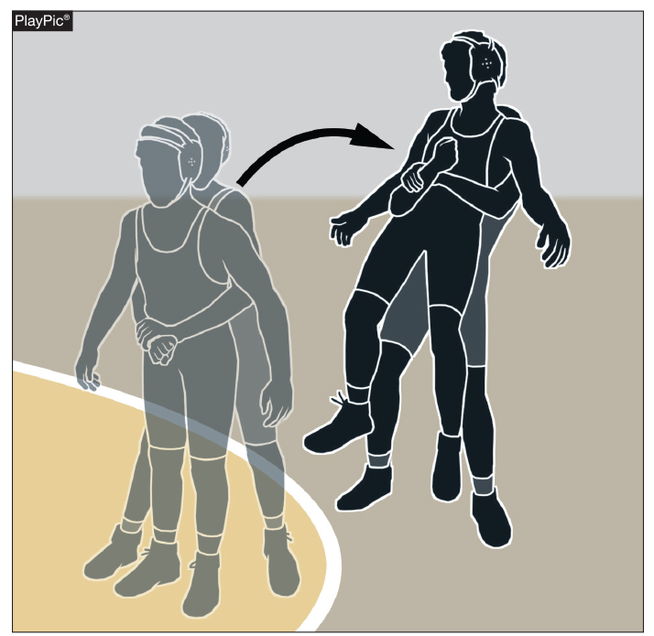
Stalling rule 5-24-3e, f
From a neutral position, the wrestler from behind is stalling if he/she pulls their opponent out of bounds off the mat. It is also stalling if a wrestler pushes their opponent out of bounds off the mat.

Slide 43
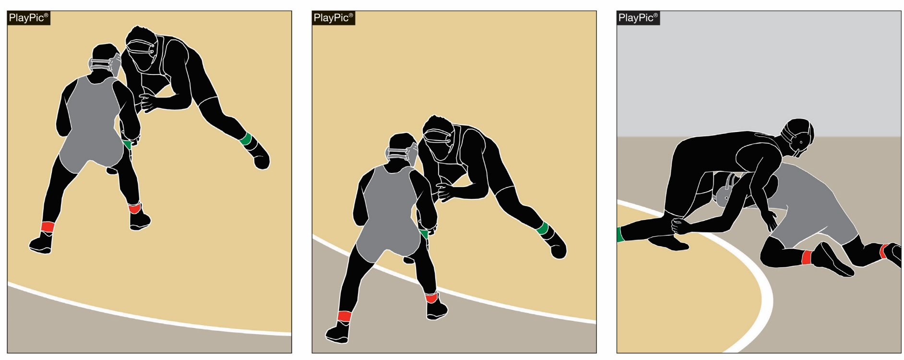
Stalling rule 5-24-3e
A
B
C
The wrestlers in PlayPic A are in a neutral position. In PlayPic B, the wrestler in gray is backing off the mat. That is stalling. It is not stalling if the wrestler backs off the mat to pivot to get into position to execute a move (PlayPic C).

Slide 44
Stalling rule 5-24-3e, f
ART. 3 . . . It is stalling in the neutral position when a wrestler:
a. continuously avoids contact with the opponent;
b. plays the edge of the mat;
c. prevents the opponent from returning to or remaining inbounds; or
d. is not attempting to secure a takedown;
e. backing off the mat, out of bounds;
f. pushing or pulling out of bounds.

Slide 45
Stalling rule 5-24-3e, f
Rationale:
The addition of these two criteria has contributed to keeping the action within the boundary lines at different positions. This modification of stalling in the neutral position has made the stalling call an easier call for the official with definitive language as a guide.

Slide 46
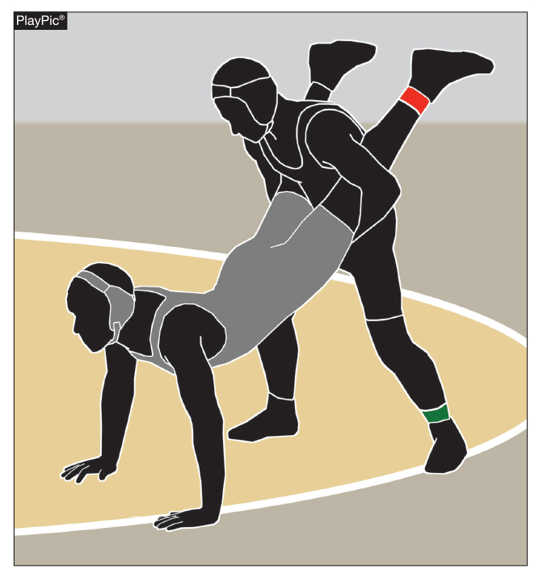
Takedown rule 5-25-3
In awarding a takedown at the edge of the mat, control must be established while a total of two supporting points of either wrestler are in bounds. The total of two supporting points could be two supporting points of one wrestler or one supporting point of each wrestler that are inbounds or while at least the feet of the scoring contestant finish down on the mat inbounds.

Slide 47
TakeDown
Rule 5-25-1
ART. 1 . . . It is a takedown when, from the neutral position, a wrestler gains control over the opponent down on the mat and a total of two supporting points of either wrestler are inbounds. The total of two supporting points could be two supporting points of one wrestler or one supporting point of each wrestler that are inbounds. When the defensive wrestler’s hand(s) touch the mat it is considered a supporting point(s). (Photos 23-30)

Slide 48
TakeDown
Rule 5-25-3
ART. 3 . . . In awarding a takedown at the edge of the mat, control must be established while a total of two supporting points of either wrestler are in bounds. The total of two supporting points could be two supporting points of one wrestler or one supporting point of each wrestler that are inbounds or while at least the feet of the scoring contestant finish down on the mat inbounds. (Photos 32-34)

Slide 49
TakeDown
Rule 5-25-3
Rationale:
This rule defines what a takedown is in conjunction with the new definition of supporting points. This simplifies the explanation with any combination of two supporting points of either wrestler is considered inbounds.

Slide 50
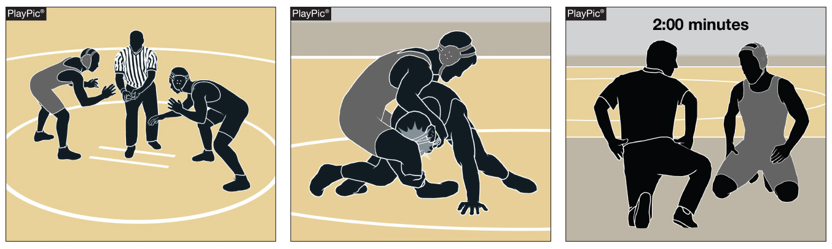
Recovery time rules 5-28-3, 8-2-2
A
B
C
From the neutral position (PlayPic A), a wrestler false starts (PlayPic B) causing an injury to their opponent. The injured wrestler is allotted 2 minutes of recovery time (PlayPic C), which is not deducted from the injured wrestler’s injury time allowance. If the injury is such the injured contestant is unable to continue following a maximum of two minutes recovery time, the injured contestant shall be awarded the match by default.

Slide 51
Recovery time rules 5-28-3, 8-2-2
ART. 3 . . . Recovery time, If a contestant is injured as a result of an illegal hold/maneuver, unnecessary roughness, unsportsmanlike conduct during the match or the result of a false start (by the opponent) in the neutral position, the wrestler is entitled to two minutes of recovery time, which is not deducted from the injured wrestler’s injury time allowance. (8-2-2)

Slide 52
Recovery time rule 8-2-2
ART. 2 . . . If a contestant is injured as a result of an illegal hold/maneuver, unnecessary roughness, unsportsmanlike conduct (during the match) or the result of a false start (by the opponent) in the neutral position, to the extent the injured contestant is unable to continue following a maximum of two minutes recovery time, the injured contestant shall be awarded the match by default.

Slide 53
Recovery time rule 8-2-2
In case of an intentional attempt to injure an opponent, the offender shall be penalized for flagrant misconduct. Recovery time for injury because of an illegal hold/maneuver is not deducted from the injured contestant’s injury-time allowance. An injured contestant cannot take injury time immediately following recovery time. (5-28-3)

Slide 54
Recovery time rules 5-28-3, 8-2-2
Rationale:
Clarification that if a wrestler is injured because of the opponent’s false start in the neutral position, then the injured wrestler should be accommodated with recovery time as part of the existing criteria.

Slide 55
Illegal hold/maneuver
Rule 7-1-5q
Under the Illustrations section in the back of the NFHS Wrestling Rules book. Illustration #83 "(7-1-5q) The back bow is illegal as illustrated by application." when the pressure is toward the head, whether the defensive wrestler is on his/her stomach or hip.
Rationale:
In the body of Rule 7, it is denoted that the "back bow" is an illegal hold/maneuver. It does not stipulate that it is illegal conditionally if pressure is used, if it is applied, then it is illegal.

Slide 56
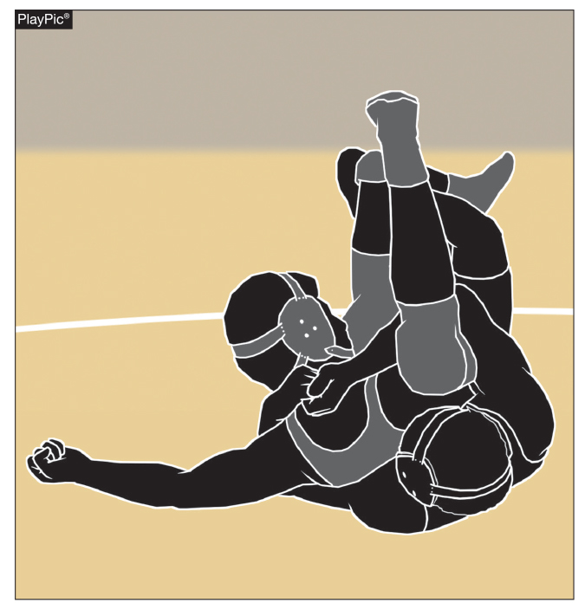
Illegal hold/maneuver rule 7-1-5y
The nelson cradle is illegal. It is a combination made up of a half nelson on one side with a locked cradle from around the neck with the far side knee. The crotch of the knee acts as the other arm (arm pit) to complete the full nelson pressure on the neck and throat.

Slide 57
Illegal hold/maneuver rule 7-1-5y
y. the Nelson-Cradle.
Rationale:
Modified that the Nelson-Cradle is an illegal hold/maneuver. The Nelson-Cradle is a combination made up of a half nelson on one side with a locked cradle from around the neck with the far side knee. The crotch of the knee acts as the other arm (arm pit) to complete the full nelson pressure on the neck and throat.

Slide 58
Illegal hold/maneuver rule 7-1-5y
Also, the action occurring on the lower spine as the knee is brought up near the head is dangerous. When the move is finished the offensive wrestler can either roll it over or draw it backward.

Slide 59
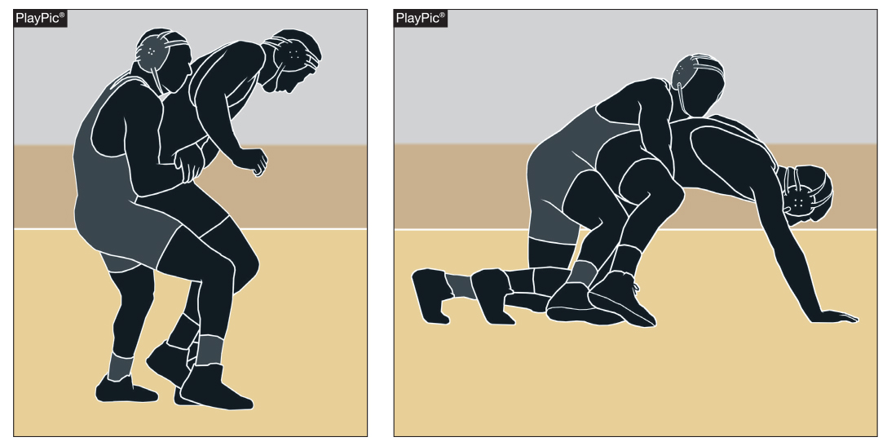
Unsportsmanlike conduct rule 7-4-2
Repeatedly dropping to one knee or one hand to break locked hands is to be ruled unsportsmanlike conduct.

Slide 60
Unsportsmanlike conduct rule 7-4-2
ART. 2 . . . Unsportsmanlike conduct involves physical or nonphysical acts and they can occur before, during or after a match. It includes, but is not limited to, such acts as failure to comply with the direction of the referee, pushing, shoving, swearing, taunting, intimidation, baiting an opponent, throwing ear guards or any other equipment, spitting and the clearing of the nasal passage in other than the proper receptacle, repeatedly dropping to one knee or one hand to break locked hands, …

Slide 61
Unsportsmanlike conduct rule 7-4-2
…indicating displeasure with a call, failure to keep shoulder straps up while on the mat and failure to comply with the end-of-match procedure. Continuing acts of unsportsmanlike conduct or any unsportsmanlike conduct may be construed as flagrant misconduct.
Rationale:
Repeatedly dropping to one hand to force an opponent to break locked hands happens just as often as repeatedly dropping to one knee. There is no difference between the two acts.

Slide 62
Unsportsmanlike conduct rule 7-4-2
This has been enforced by many officials without proper rule coverage. This conduct is now being addressed in the rules book.

Slide 63
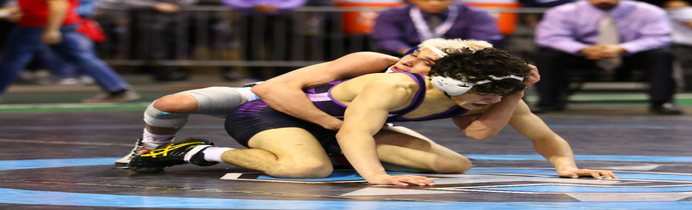
Points of Emphasis

Slide 64
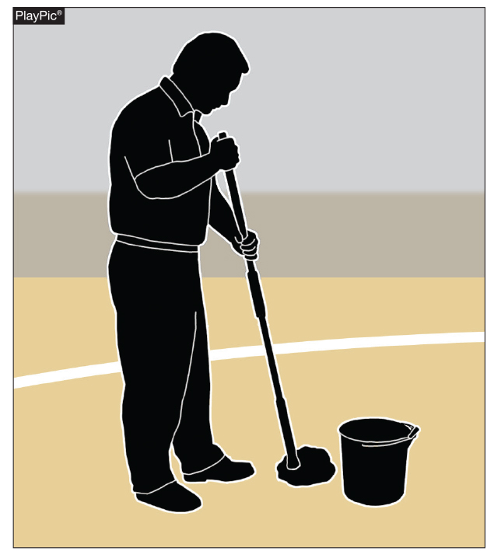
cleanliness
Among the ways to prevent the spread of communicable skin diseases:
• Clean wrestling mats daily with a
solution of 10:100 bleach and water or an appropriate commercial cleaner.
• Maintain proper ventilation in the
wrestling room to prevent the build-up of heat and humidity.
• Clean all workout gear after each
practice including towels, clothing,
headgear, shoes, knee pads, etc.
• Require each wrestler to shower
after each practice and competition with
an antibacterial soap. Do not share bars of soap. Use individual soap dispensers.

Slide 65
Cleanliness of uniforms and pads
Communicable diseases are a major concern in wrestling.
Preventing the spread of communicable diseases is to properly clean all the mats, uniforms and pads
  A 10% household bleach mixed in to 10 parts of water is an effective disinfectant.
  Commercial disinfectants are also available.
    Be sure that they are effective against viruses, fungi and bacteria.

Slide 66
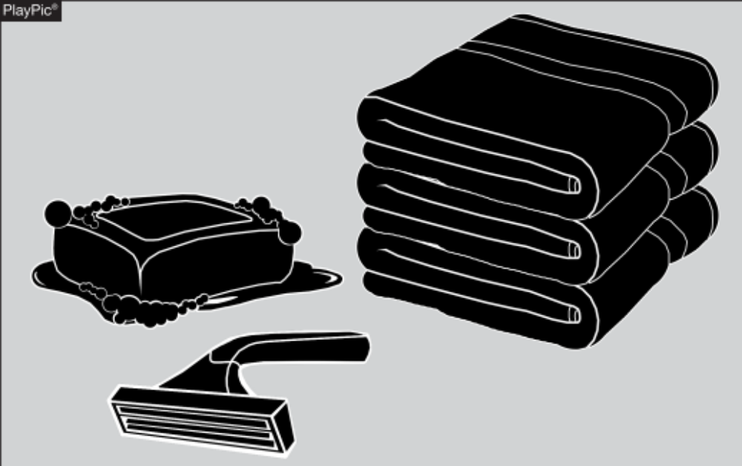
Communicable skin conditions and skin checks
One of the keys to preventing the spread of communicable skin conditions is to have wrestlers refrain from sharing soap, razors or towels.

Slide 67
Cleanliness of uniforms and pads
It is imperative to clean all wrestling equipment and clothing daily.
Items such as:
  Towels
  Uniforms
  Any clothing
  Headgear
  Shoes
  Knee pads
  Any bags that transport the equipment

Slide 68
Cleanliness of uniforms and pads
Emphasize the importance of showering with soap and water. If shower facilities are not available then use “baby wipes” to clean any exposed skin after practice and competition.
Coaches or trainers should perform daily skin checks.

Slide 69
Cleanliness of uniforms and pads
Wrestlers should not share practice/competition gear, towels, or any personal hygiene products.
Wrestlers should refrain from cosmetic shaving parts of their body other than their face.
Wrestlers should clean hands with alcohol-base gel prior to every wrestling match to avoid bacterial loading.

Slide 70
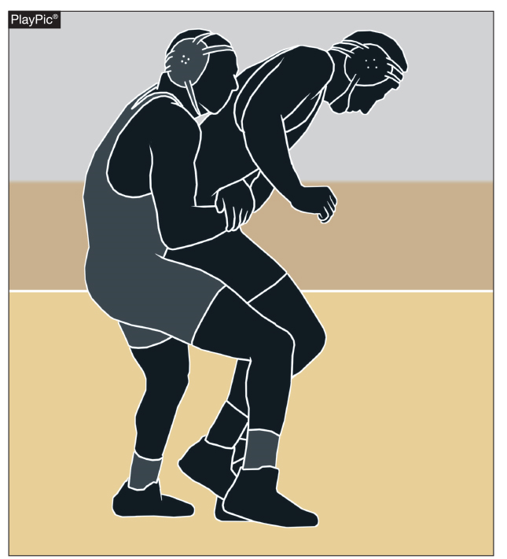
Stalling

Slide 71
stalling
Wrestling is an aggressive endeavor and should be coached and executed in that manner. It is expected that wrestlers stay inbounds and compete. There is no passive wrestling. There are no provisions in the rules to allow a wrestler to rest.

Slide 72
stalling
Backing off the mat out bounds, pushing or pulling the opponent out of bounds, hands locked around leg of an opponent without the intent of taking him or her down or preventing the opponent from scoring is considered stalling. The referee should be firm and consistent in enforcing the letter and spirit of the rule.

Slide 73
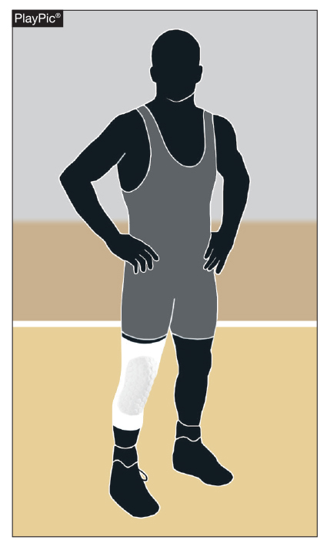
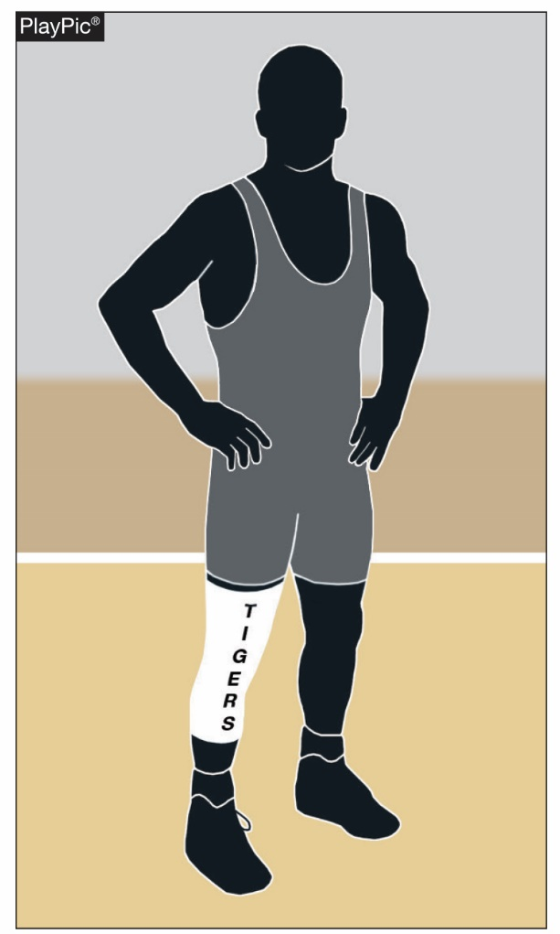
Special equipment

Slide 74
Special Equipment
Special equipment is identified in Rule 4-3-1 as any equipment that is not required by rule. All special equipment should be presented prior to stepping on the mat to begin wrestling.
In fact, it is a requirement by rule that the referee will decide on the legality of such equipment.

Slide 75
Special equipment
Any equipment that prevents normal movement of the joints and which prevents one’s opponent from applying normal holds/maneuvers should not be allowed.
It is reasonable for the wrestler to present his/her special equipment during the weigh-in/skin check period.

Slide 76
Special equipment
The piece of equipment to the left is a knee pad. The piece of equipment to the right is a leg sleeve.
It is the up to the discretion of each high school state association to decide if they allow the leg sleeve that are presented in their state.

Slide 77

Preventing injuries From False Starts in the Neutral Position

Slide 78
Preventing injuries From False Starts in the Neutral Position
A number of injuries are occurring due to false starts in the neutral position. This is a preventable injury.
It is imperative that the official use proper mechanics to prevent neutral false starts.
When starting the match in the neutral position, the official shall position themselves between the wrestlers to prevent a false start.
The official shall blow their whistle as they step back from between the wrestlers.

Slide 79
Preventing injuries From False Starts in the Neutral Position
This mechanic should be a visible reminder to wrestlers that we are concerned about unnecessary injuries that can be alleviated with attention to false starts.

Slide 80
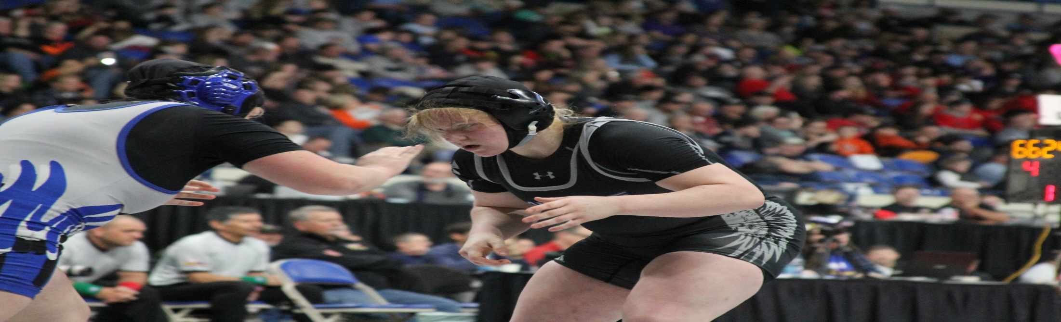
Nfhs wrestling Editorial changes

Slide 81
Rule 4-1-1a
Change:
a. A one-piece singlet cut no lower in the back or front than the level of the armpits and under the arms no lower than one-half the distance between the armpit and the belt line. The one-piece singlet may be worn with full-length tights with stirrups.

Slide 82
Rule 4-1-1a
Any other undergarment worn under the one-piece singlet which extends beyond the inseam shall be tight-fitting, a single solid color, unadorned and shall not extend below the knee. The one-piece singlet shall be school-issued.
Rationale:
Because the new rules approve the use of school issued compression shorts to be worn under a one-piece singlet, the wording single solid color and unadorned no longer applies.

Slide 83
RULE 4-1-1c
Change:
c. Full-length tights with stirrups are acceptable under a one-piece uniform. Any other undergarment that extends beyond the inseam of a one-piece uniform shall be a tight-fitting, single solid color, unadorned and shall not extend below the knee.
Rationale:
Because the new rules approve the use of a school issue compression short which could be multi-colored and adorned to be worn under a one-piece singlet this wording is no longer needed.

Slide 84
RULE 6-6-5a.2.
Change:
Match Score
Errors involving the computation of match score must be corrected within 30 minutes after the conclusion of the dual meet. If the error necessitates additional wrestling, it must be corrected prior to the next match.

Slide 85
RULE 6-6-5a.2.
2. Errors involving the computation of match score must be corrected prior to the next match in which either wrestler competes. If the error necessitates additional wrestling it must be corrected prior to the offended contestant leaving the mat area and prior to the start of the next match on that mat.
Rationale:
The above change was approved last year and was incorrectly edited into the rulebook.

Slide 86
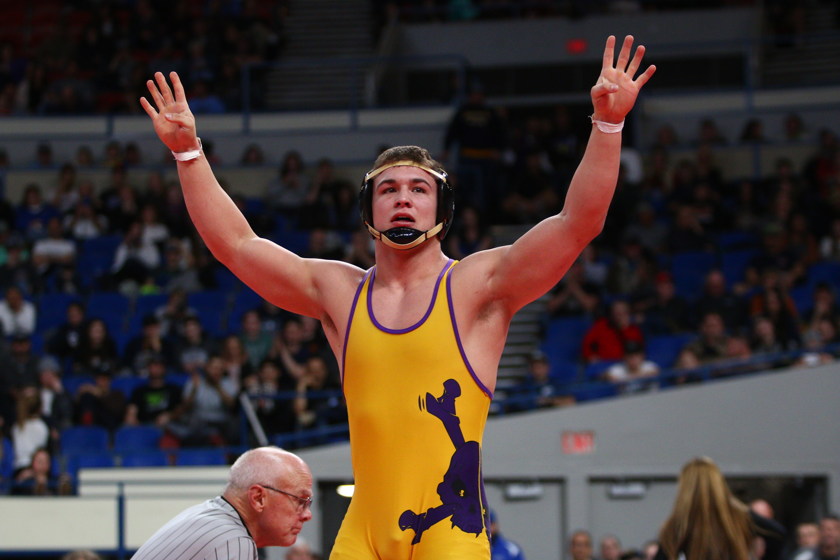
NFHS Wrestling Rule
Correction

Slide 87
Rule 6-4-1
ART. 1 . . . When there is no longer a total of two supporting points of either wrestler on or inside the boundary line, wrestling shall be stopped and wrestlers returned to the center of the mat and started according to the position of each at the time they went out of bounds.

Slide 88
Rule 6-4-1
The total of two supporting points could be two supporting points of one wrestler or one supporting point of each wrestler inside or on the boundary line. If the wrestlers go out of bounds in the neutral position, the match shall be resumed with each wrestler at the designated green or red area.
Rationale:
Rule change was not given proper acknowledgement within the NFHS Wrestling Comments of the 2018-19 Rule Changes.

Slide 89
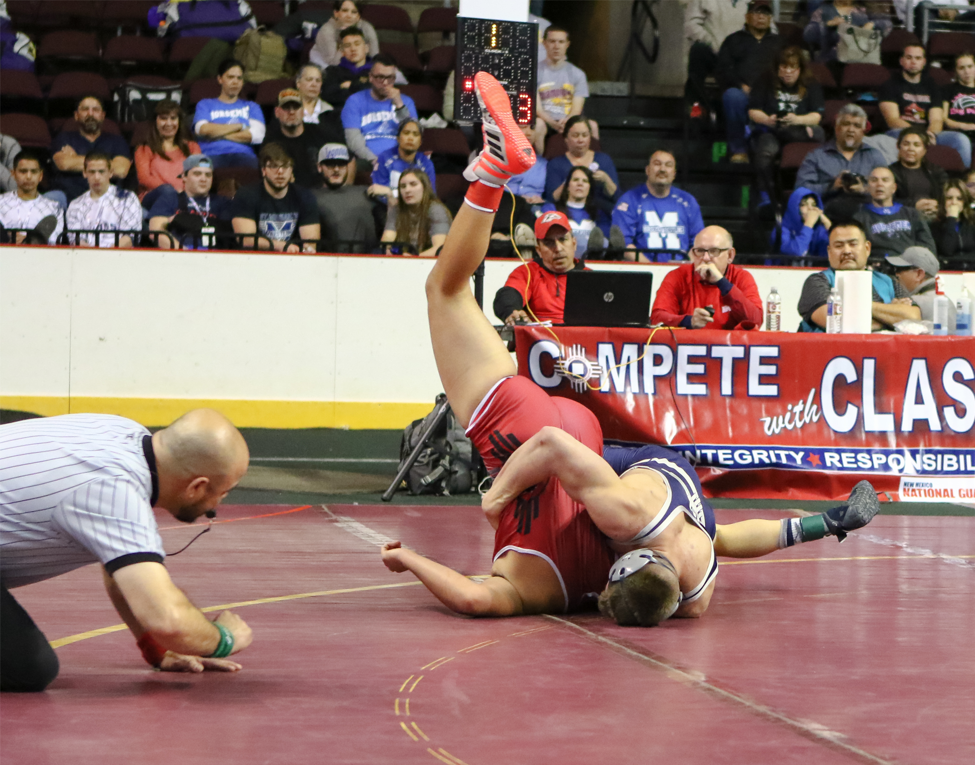
NFHS Officials Association
Central Hub

Slide 90

NFHS Officials Association Central Hub
https://nfhs-wrestling.arbitersports.com/front/105418/Site
Contains:
  Sport information
  Rules information
  Rules library
  Searchable rules book
  Video content on officiating sport, competition situations and interpretations

Slide 91
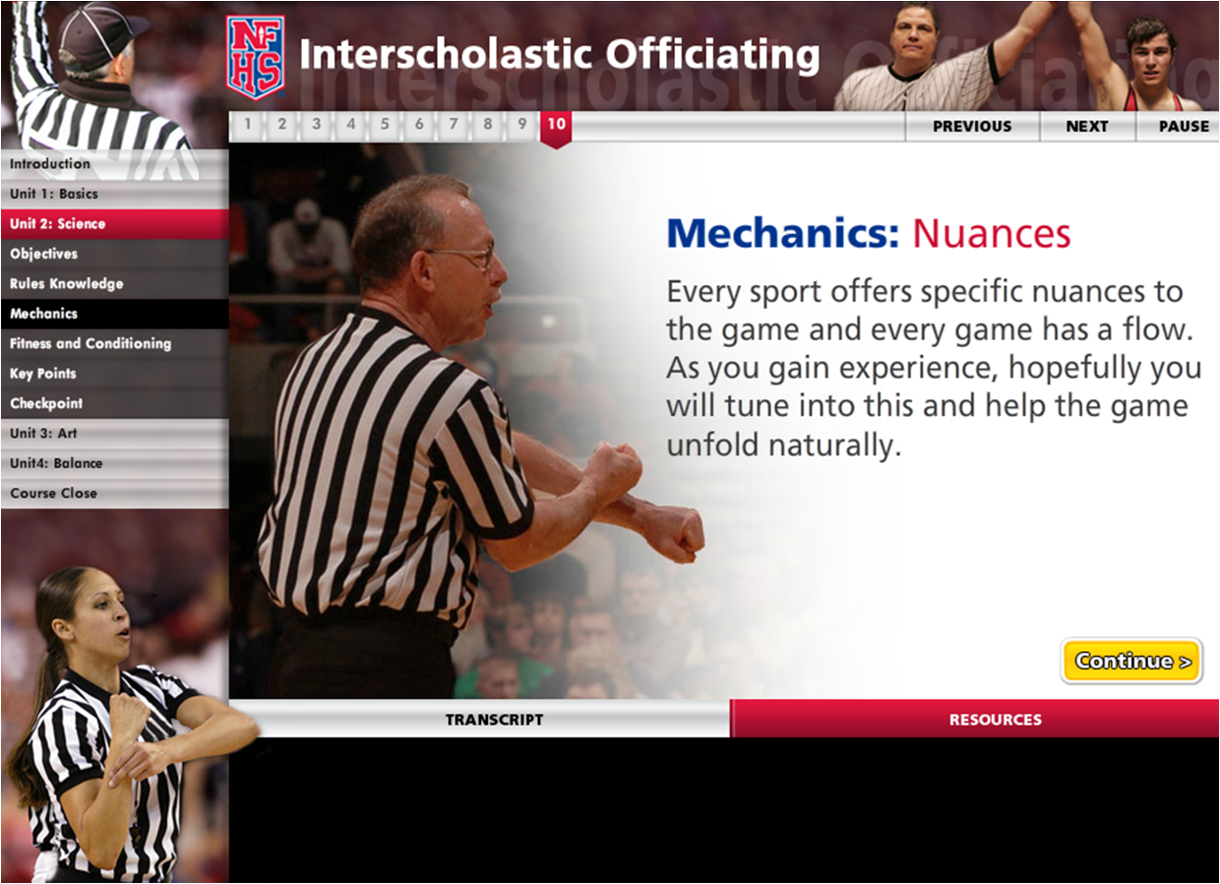
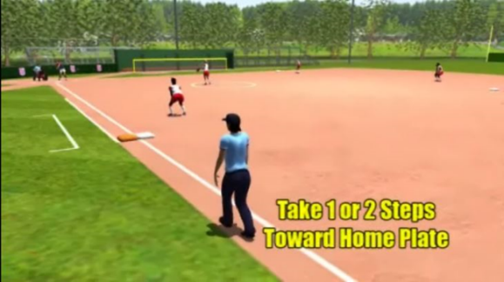
NFHS Officials education
Course and videos
Ideal for new officials or those in first few years of officiating
30-45 minutes to complete
Topics include: Basics of Becoming and Staying an Official, Science of Officiating, Art of Officiating
Course is FREE to NFHS Officials Association members, non-members fee is $20
NFHSLearn.com
Sports such as soccer, basketball and baseball offer direct illustrations of the rules book, including rules references and officials signals
Animated mechanics videos for softball and baseball umpires
Video interpretation of the NFHS Basketball Rules Book created through a partnership with the International Association of Approved Basketball Officials

Slide 92
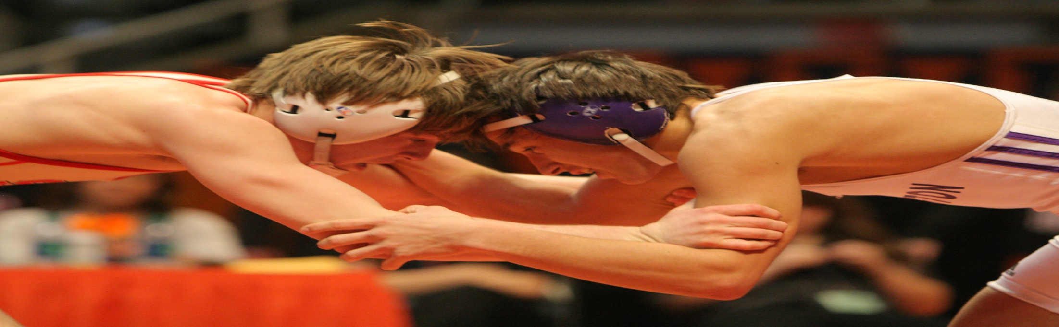
NFHS Learning center

Slide 93

The NFHS Learning Center
Mission: Provide ongoing professional development for Coaches, Administrators, Students, Parents and Officials on the role they play within interscholastic athletics and activities.

Slide 94

www.NFHSLearn.com
Register on
NFHSLearn.com and
receive the following
great benefits:
  Immediate access to all 18 NFHS free courses
  Opportunity to receive email updates on your sport, upcoming courses and much more
  Access coursework 24/7/365
  Access completion certificates 24/7/365

Slide 95

Notes:
About: Coaching Wrestling developed by the NFHS in partnership with the National Wrestling Coaches Association, provides a unique student-centered curriculum on essential wrestling coaching techniques and methods for interscholastic teacher/coaches. This course also shares practical methods for increasing student participation through effective feedback and stress reduction.

Slide 96






NFHS FREE Courses
Concussion in Sports
Coaching Pole Vault
NCAA Eligibility
Positive Sport Parenting
Sportsmanship
Sports Nutrition
Heat Illness Prevention
Introduction to Music Adjudication
Introduction to Pitch Smart
Learning Pro – Suite of 4 courses
Coaching Unified Sports
Creating a Safe and Respectful Environment
Engaging Effectively with Parents
Sudden Cardiac Arrest
Captains Course
Interscholastic Officiating
National Coach Certification Program

Slide 97
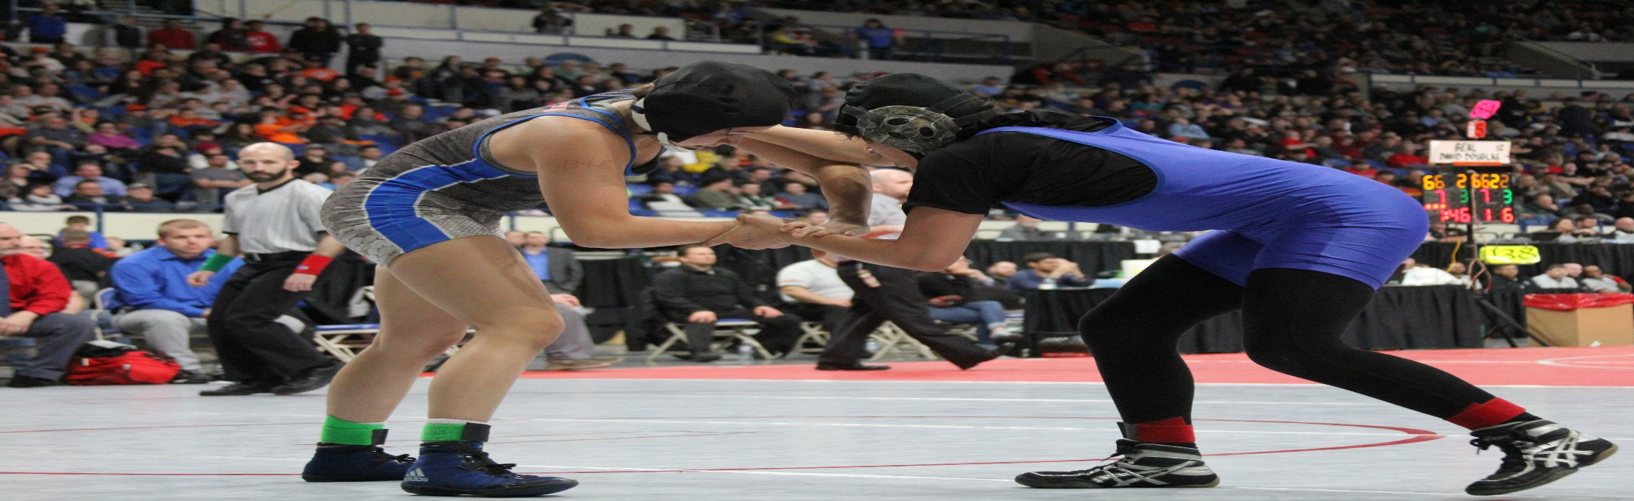
NFHS Network

Slide 98

NFHS Network
By 2020, every high school sporting event in America will be streamed live.
The NFHS Network will be THE DESTINATION for fans to view these broadcasts.

Slide 99



Slide 100
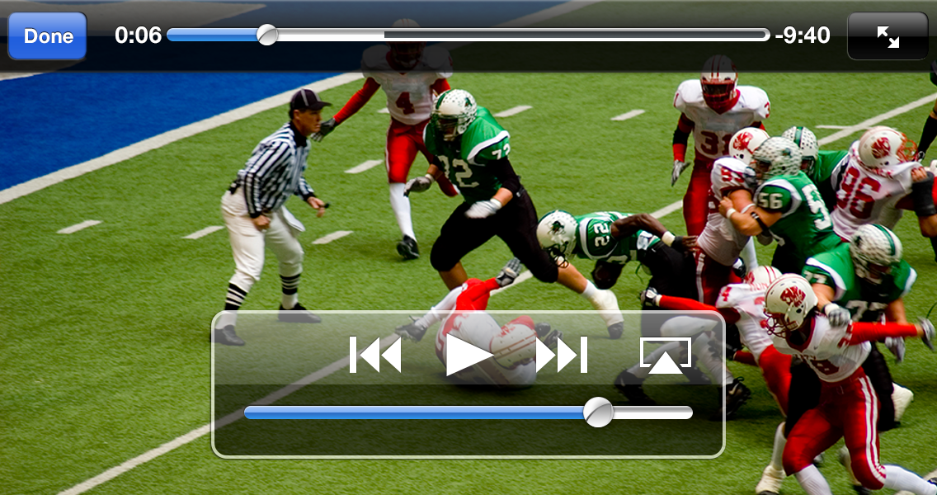
NFHS Network
View from mobile…

Slide 101
Thank You and have a great wrestling season!
www.nfhs.org

